Slide 1
5 voices, 10 stories:
Groningen Harmonization Exercise
IALSA
Andrey Koval
2016-04-21
Groningen, NL

Slide 2
describe|
|harmonize
smoking
D
H
ALSA
dto
age
dto
D
H
LBLS
sex
D
H
Ellis
Island
education
SATSA
harmony
dto
D
H
marital
SHARE
D
H
…
TILDA
construct
D
H

Slide 3
prelude-describe|
|harmonize-sonata
smoking
D
H
ALSA
dto
age
dto
D
H
LBLS
sex
D
H
Ellis
Island
education
SATSA
harmony
dto
D
H
marital
SHARE
D
H
…
TILDA
construct
D
H

Slide 4
describe|
|harmonize
smoking
D
H
ALSA
dto
age
dto
D
H
LBLS
sex
D
H
Ellis
Island
education
SATSA
harmony
dto
D
H
marital
SHARE
D
H
…
TILDA
construct
D
H

Slide 5
describe|
|harmonize
./manipulation/0-ellis-island.R
Reads in raw data files from the candidate studies
Extract, combines, and exports their metadata
Augments raw metadata with instructions for renaming and classifying variables.
Combines unit and metadata into a single DTO to serve as a starting point to all subsequent analyses.
smoking
D
H
ALSA
dto
age
dto
D
H
LBLS
sex
D
H
Ellis
Island
education
SATSA
harmony
dto
D
H
marital
SHARE
D
H
…
TILDA
construct
D
H

Slide 6
describe|
|harmonize
smoking
D
H
ALSA
dto
age
dto
D
H
LBLS
sex
D
H
Ellis
Island
education
SATSA
harmony
dto
D
H
marital
SHARE
D
H
…
TILDA
construct
D
H

Slide 7
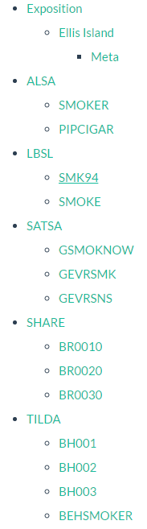
describe|
|harmonize
smoking
D
H
ALSA
dto
age
dto
D
H
LBLS
sex
D
H
Ellis
Island
education
SATSA
harmony
dto
D
H
marital
SHARE
D
H
…
TILDA
construct
D
H

Slide 8
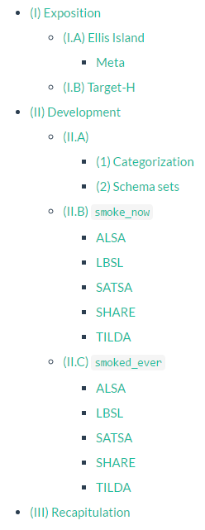
describe|
|harmonize
smoking
D
H
ALSA
dto
age
dto
D
H
LBLS
sex
D
H
Ellis
Island
education
SATSA
harmony
dto
D
H
marital
SHARE
D
H
…
TILDA
construct
D
H

Slide 9
prelude-describe|
|harmonize-sonata
smoking
D
H
ALSA
dto
age
dto
D
H
LBLS
sex
D
H
Ellis
Island
education
SATSA
harmony
dto
D
H
marital
SHARE
D
H
…
TILDA
construct
D
H

Slide 10
describe|
|harmonize
TARGET:
(1) smoke_now : Are you a smoker presently?
0 - FALSE- healthy choice
1 - TRUE- unhealthy choice
(2) smoked_ever Have you ever smoked?
0 - FALSE- healthy choice
1 - TRUE- unhealthy choice
smoking
D
H
ALSA
dto
age
dto
D
H
LBLS
sex
D
H
Ellis
Island
H
education
SATSA
harmony
dto
D
H
marital
SHARE
D
H
…
TILDA
construct
D
H

Slide 11
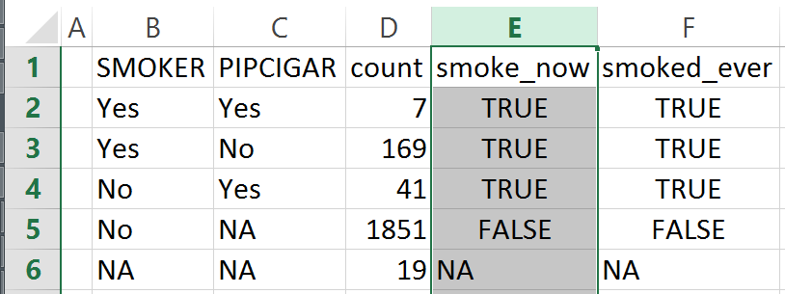
describe|
|harmonize
smoking
D
H
ALSA
ALSA
dto
age
dto
D
H
LBLS
sex
D
H
Ellis
Island
H
education
SATSA
harmony
dto
D
H
marital
SHARE
D
H
./data/meta/h-rules
…
TILDA
construct
D
H

Slide 12
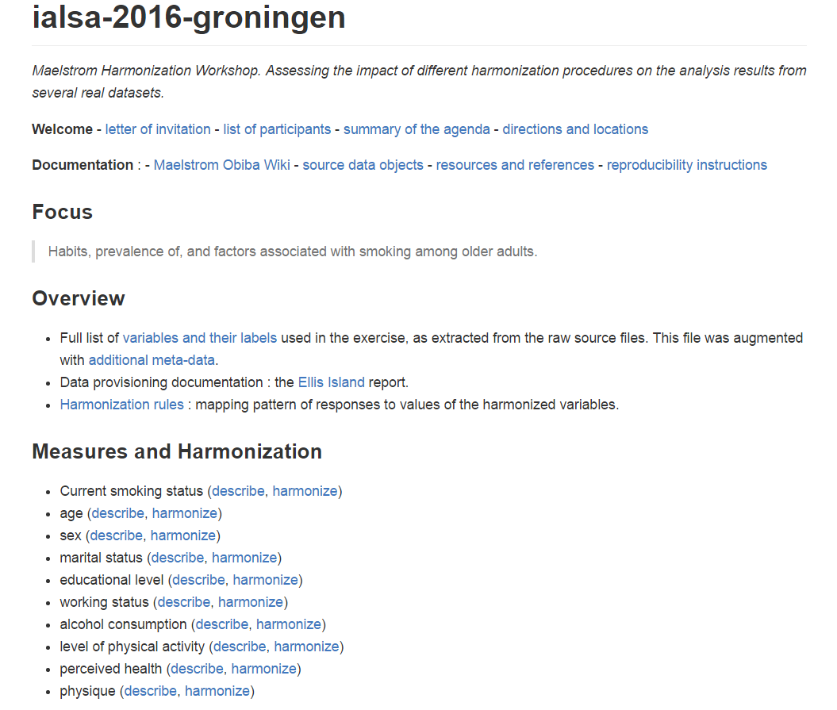

Slide 13
describe|
|harmonize
TARGET:
year_of_wave - the calendaric year in which the measurement wave occured
year_born - the calendaric year in which the respondent was born
age_in_years - the age of respondent in years
smoking
D
H
ALSA
dto
age
dto
D
H
LBLS
sex
D
H
Ellis
Island
education
SATSA
harmony
dto
D
H
marital
SHARE
D
H
…
TILDA
construct
D
H

Slide 14
describe|
|harmonize
TARGET:
(1) female: Is respondent female?
0 - FALSE
1 - TRUE
smoking
D
H
ALSA
dto
age
dto
D
H
LBLS
sex
D
H
Ellis
Island
education
SATSA
harmony
dto
D
H
marital
SHARE
D
H
…
TILDA
construct
D
H

Slide 15
describe|
|harmonize
TARGET:
(1) educ3: Education level
-1 – less than high school
0 - high school
1 – more than high school
smoking
D
H
ALSA
dto
age
dto
D
H
LBLS
sex
D
H
Ellis
Island
education
SATSA
harmony
dto
D
H
marital
SHARE
D
H
…
TILDA
construct
D
H

Slide 16
describe|
|harmonize
TARGET:
(1) marital: Marital status
-1 - mar_cohab - married or cohabiting
0 – single - not married
1 - sep_divorced - separated or divorced
2 - widowed - widowed
smoking
D
H
ALSA
dto
age
dto
D
H
LBLS
sex
D
H
Ellis
Island
education
SATSA
harmony
dto
D
H
marital
SHARE
D
H
…
TILDA
construct
D
H

Slide 17
describe|
|harmonize
TARGET:
(1) current_work_2: Currently employed?
0 - FALSE
1 - TRUE
smoking
D
H
ALSA
dto
age
dto
D
H
LBLS
sex
D
H
Ellis
Island
education
SATSA
harmony
dto
D
H
marital
SHARE
D
H
…
TILDA
construct
D
H

Slide 18
describe|
|harmonize
TARGET:
(1) current_drink: Consumes currently?
0 - FALSE
1 – TRUE
smoking
D
H
ALSA
dto
age
dto
D
H
LBLS
sex
D
H
Ellis
Island
education
SATSA
harmony
dto
D
H
marital
SHARE
D
H
…
TILDA
construct
D
H

Slide 19
describe|
|harmonize
TARGET:
(1) sedentary: Walking or better
0 - FALSE
1 – TRUE
smoking
D
H
ALSA
dto
age
dto
D
H
LBLS
sex
D
H
Ellis
Island
education
SATSA
harmony
dto
D
H
marital
SHARE
D
H
…
TILDA
construct
D
H

Slide 20
describe|
|harmonize
TARGET:
(1) poor_health: less than “good”
0 - FALSE
1 – TRUE
smoking
D
H
ALSA
dto
age
dto
D
H
LBLS
sex
D
H
Ellis
Island
education
SATSA
harmony
dto
D
H
marital
SHARE
D
H
…
TILDA
construct
D
H

Slide 21
describe|
|harmonize
TARGET:
(1) bmi: measure of physique
bmi = weight_kg / height_m ^ 2
bmi = weight_lb * 703 / height_in ^ 2
smoking
D
H
ALSA
dto
age
dto
D
H
LBLS
sex
D
H
Ellis
Island
education
SATSA
harmony
dto
D
H
marital
SHARE
D
H
…
TILDA
construct
D
H

Slide 22
describe|
|harmonize
smoking
D
H
ALSA
dto
age
dto
D
H
LBLS
sex
D
H
Ellis
Island
education
SATSA
harmony
dto
D
H
marital
SHARE
D
H
…
TILDA
construct
D
H

Slide 23
prelude|
|sonata
smoking
D
H
ALSA
dto
age
dto
D
H
LBLS
sex
D
H
Ellis
Island
education
SATSA
harmony
dto
D
H
marital
SHARE
D
H
…
TILDA
construct
D
H

Slide 24
prelude|
|sonata
smoking
D
H
ALSA
dto
age
dto
D
H
LBLS
sex
D
H
Ellis
Island
education
SATSA
harmony
dto
D
H
marital
SHARE
D
H
…
TILDA
construct
D
H

Slide 25
prelude|
|sonata
smoking
D
H
ALSA
dto
age
dto
D
H
LBLS
sex
D
H
Ellis
Island
education
SATSA
harmony
dto
D
H
marital
SHARE
D
H
…
TILDA
construct
D
H

Slide 26
dto
graph
harmony
dto
model

Slide 27
dto
graph
smoke_now
harmony
dto
model

Slide 28
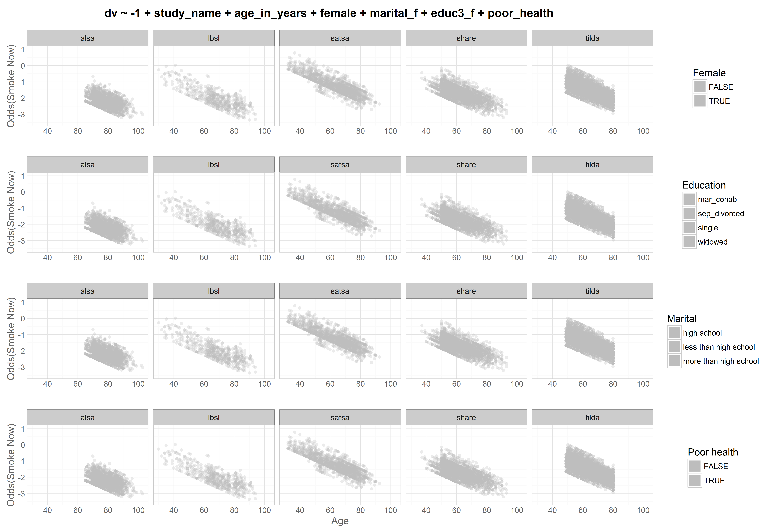
Odds|
|Prob
dto
harmony
dto

Slide 29
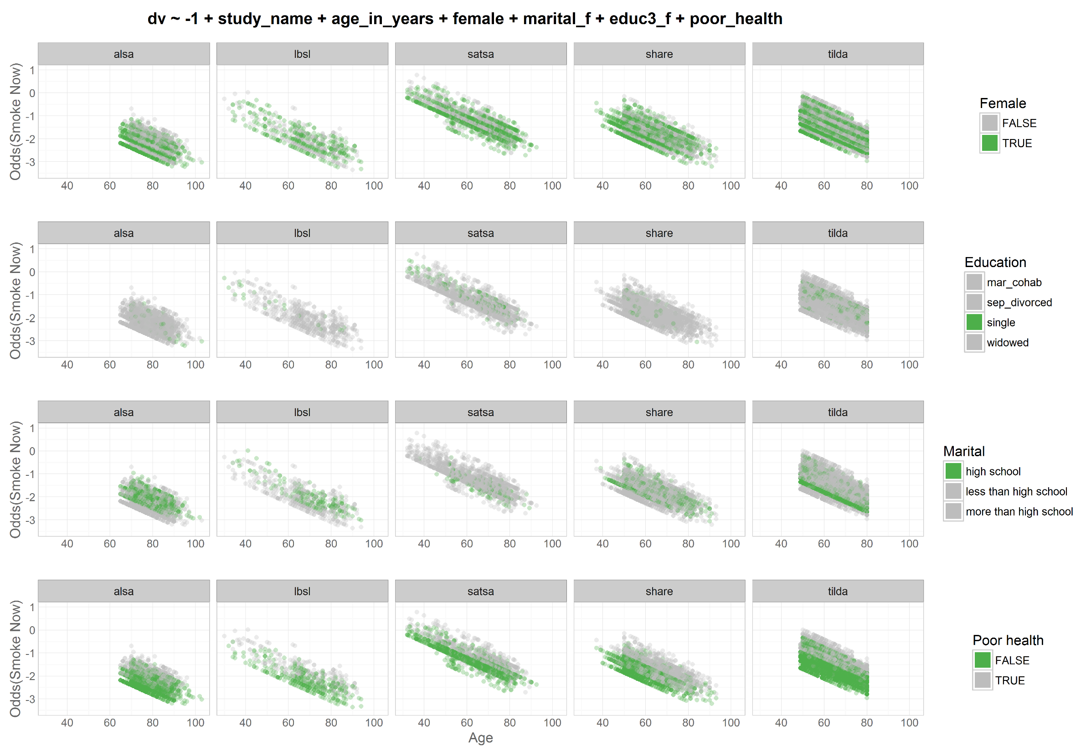
Odds|
|Prob
dto
harmony
dto

Slide 30
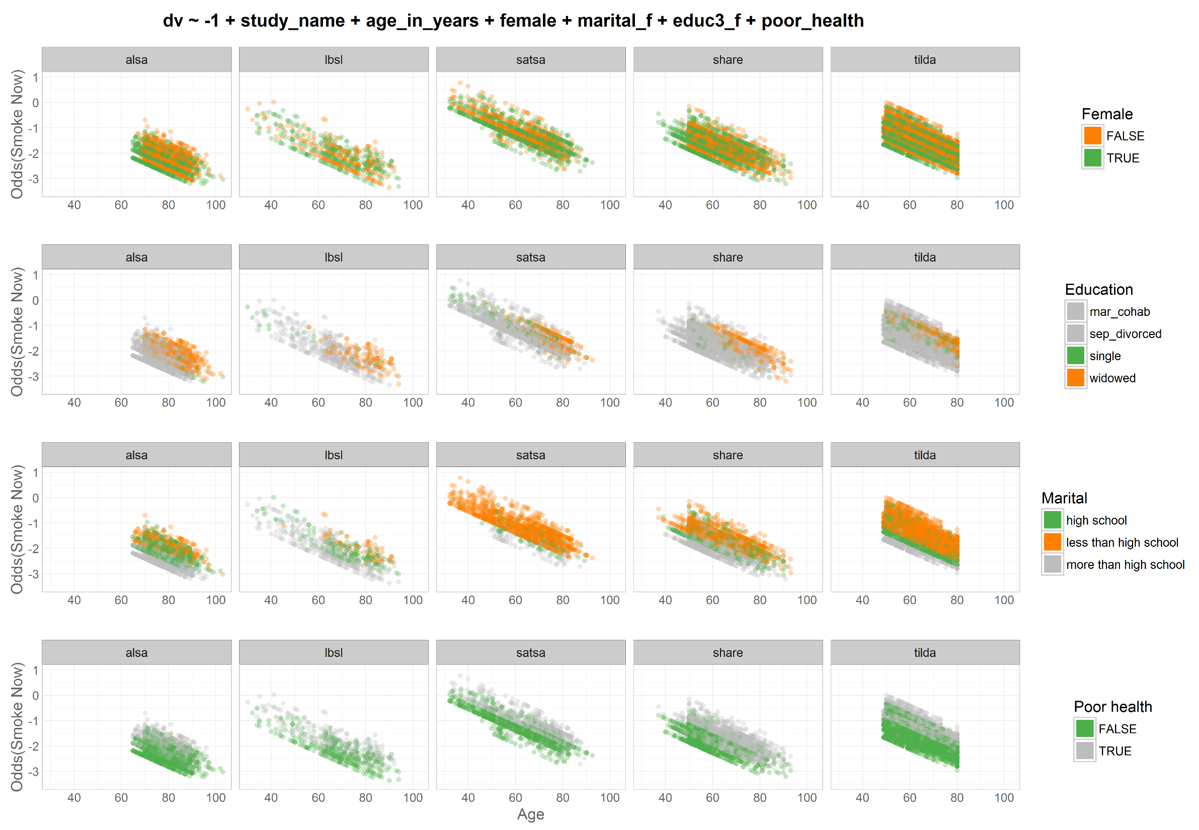
Odds|
|Prob
dto
harmony
dto

Slide 31
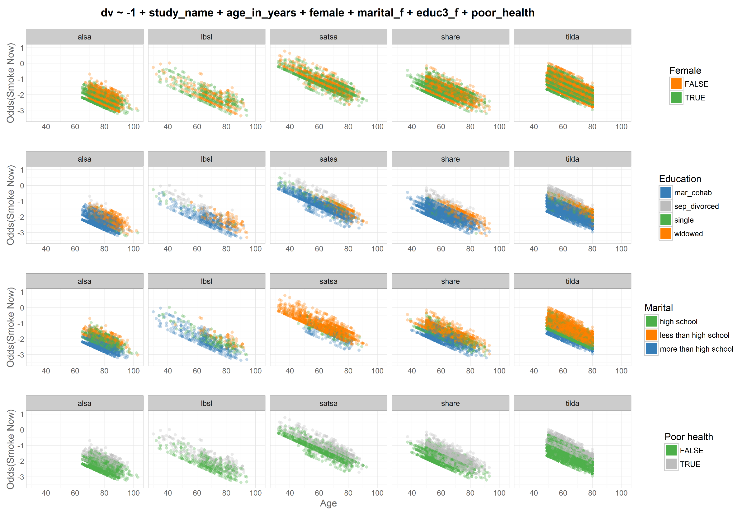
Odds|
|Prob
dto
harmony
dto

Slide 32
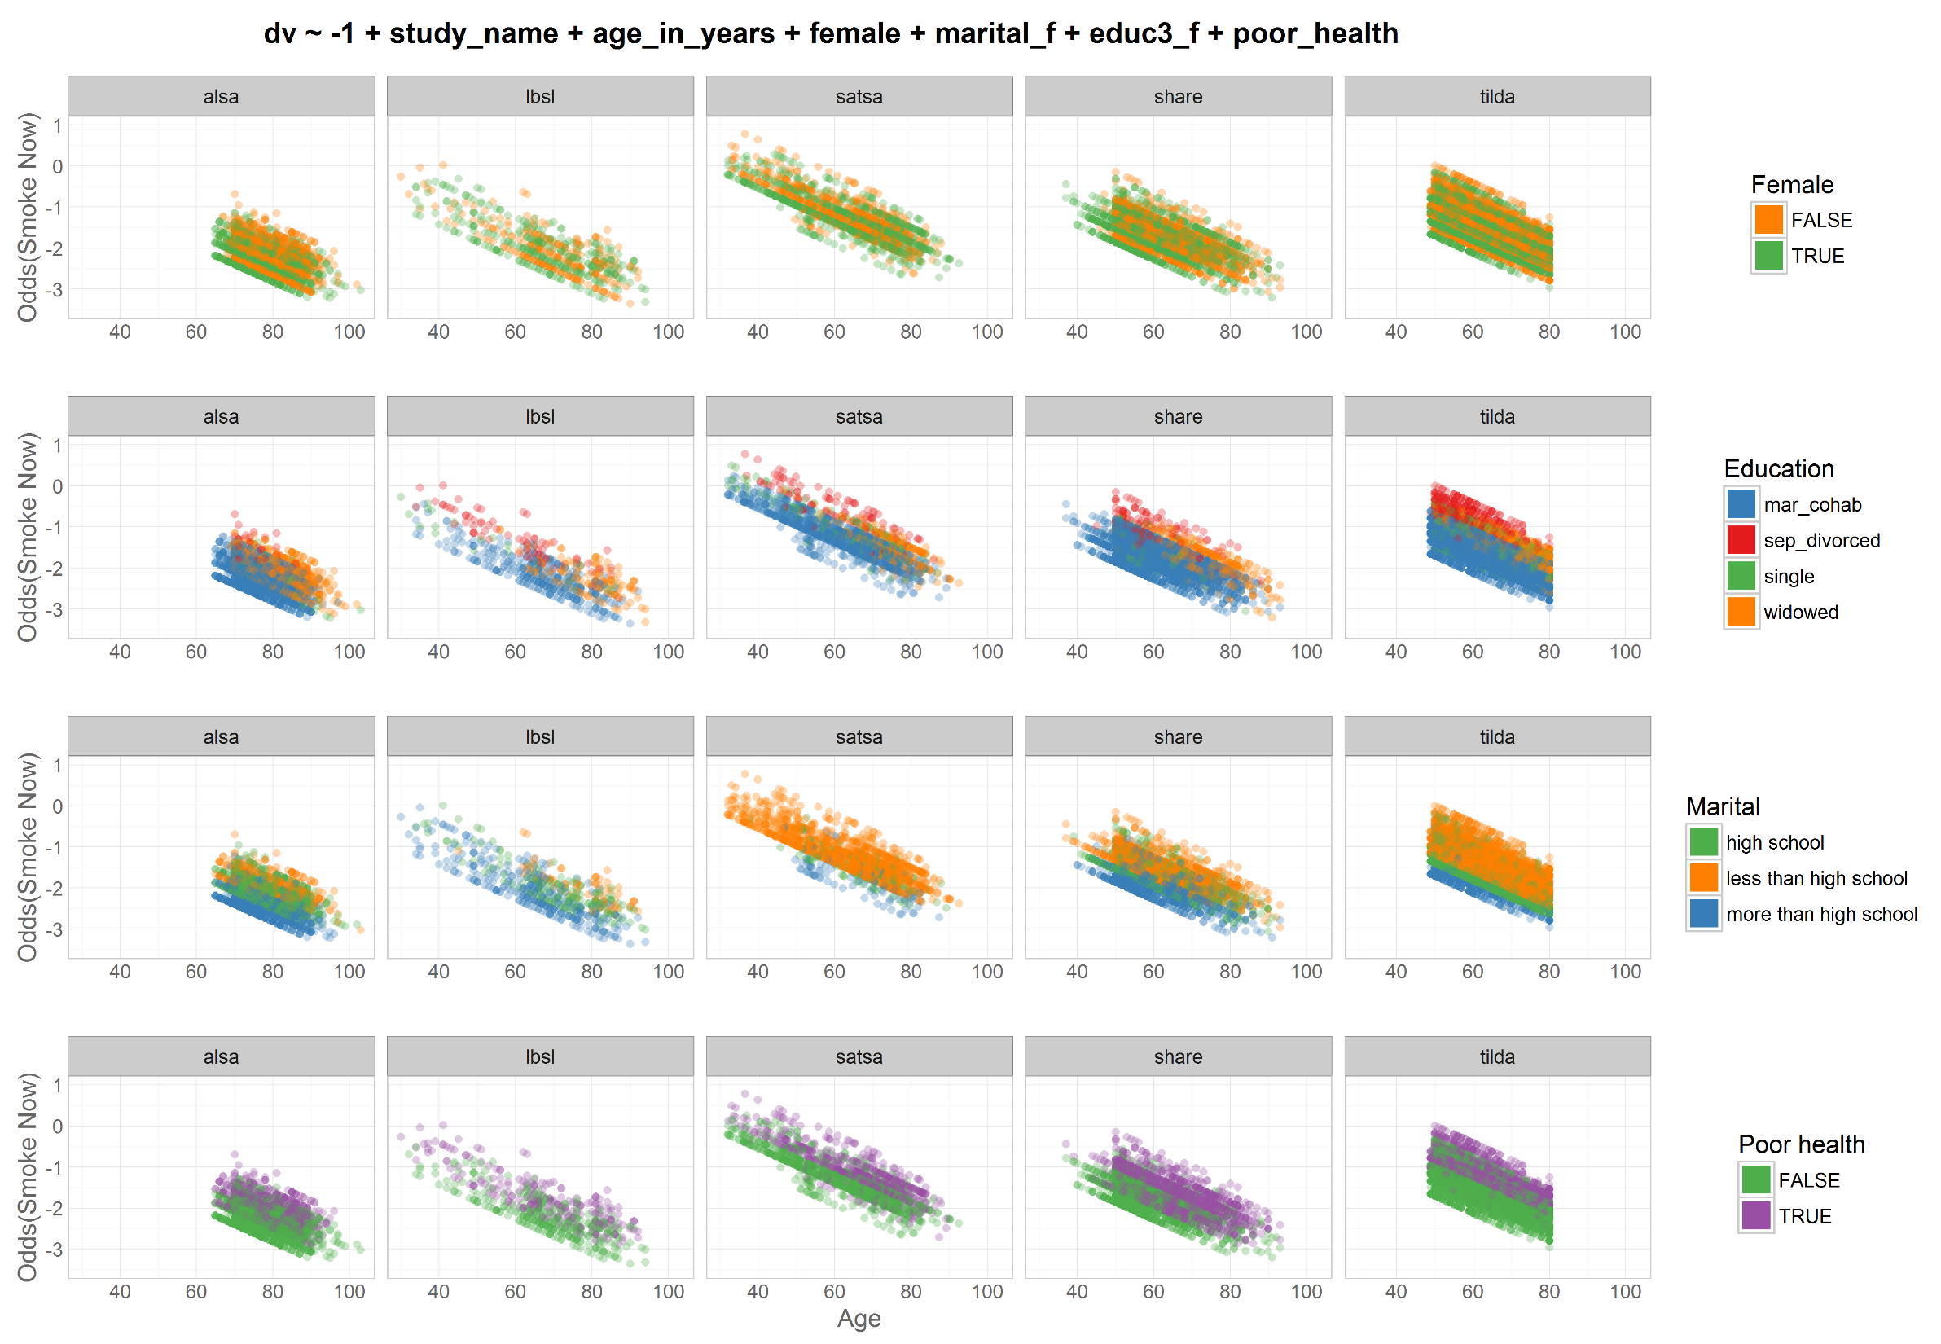
Odds|
|Prob
dto
harmony
dto

Slide 33
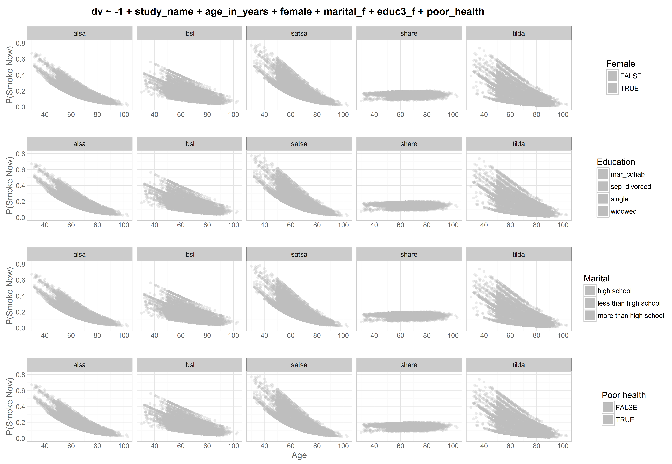
Odds|
|Prob
dto
harmony
dto

Slide 34
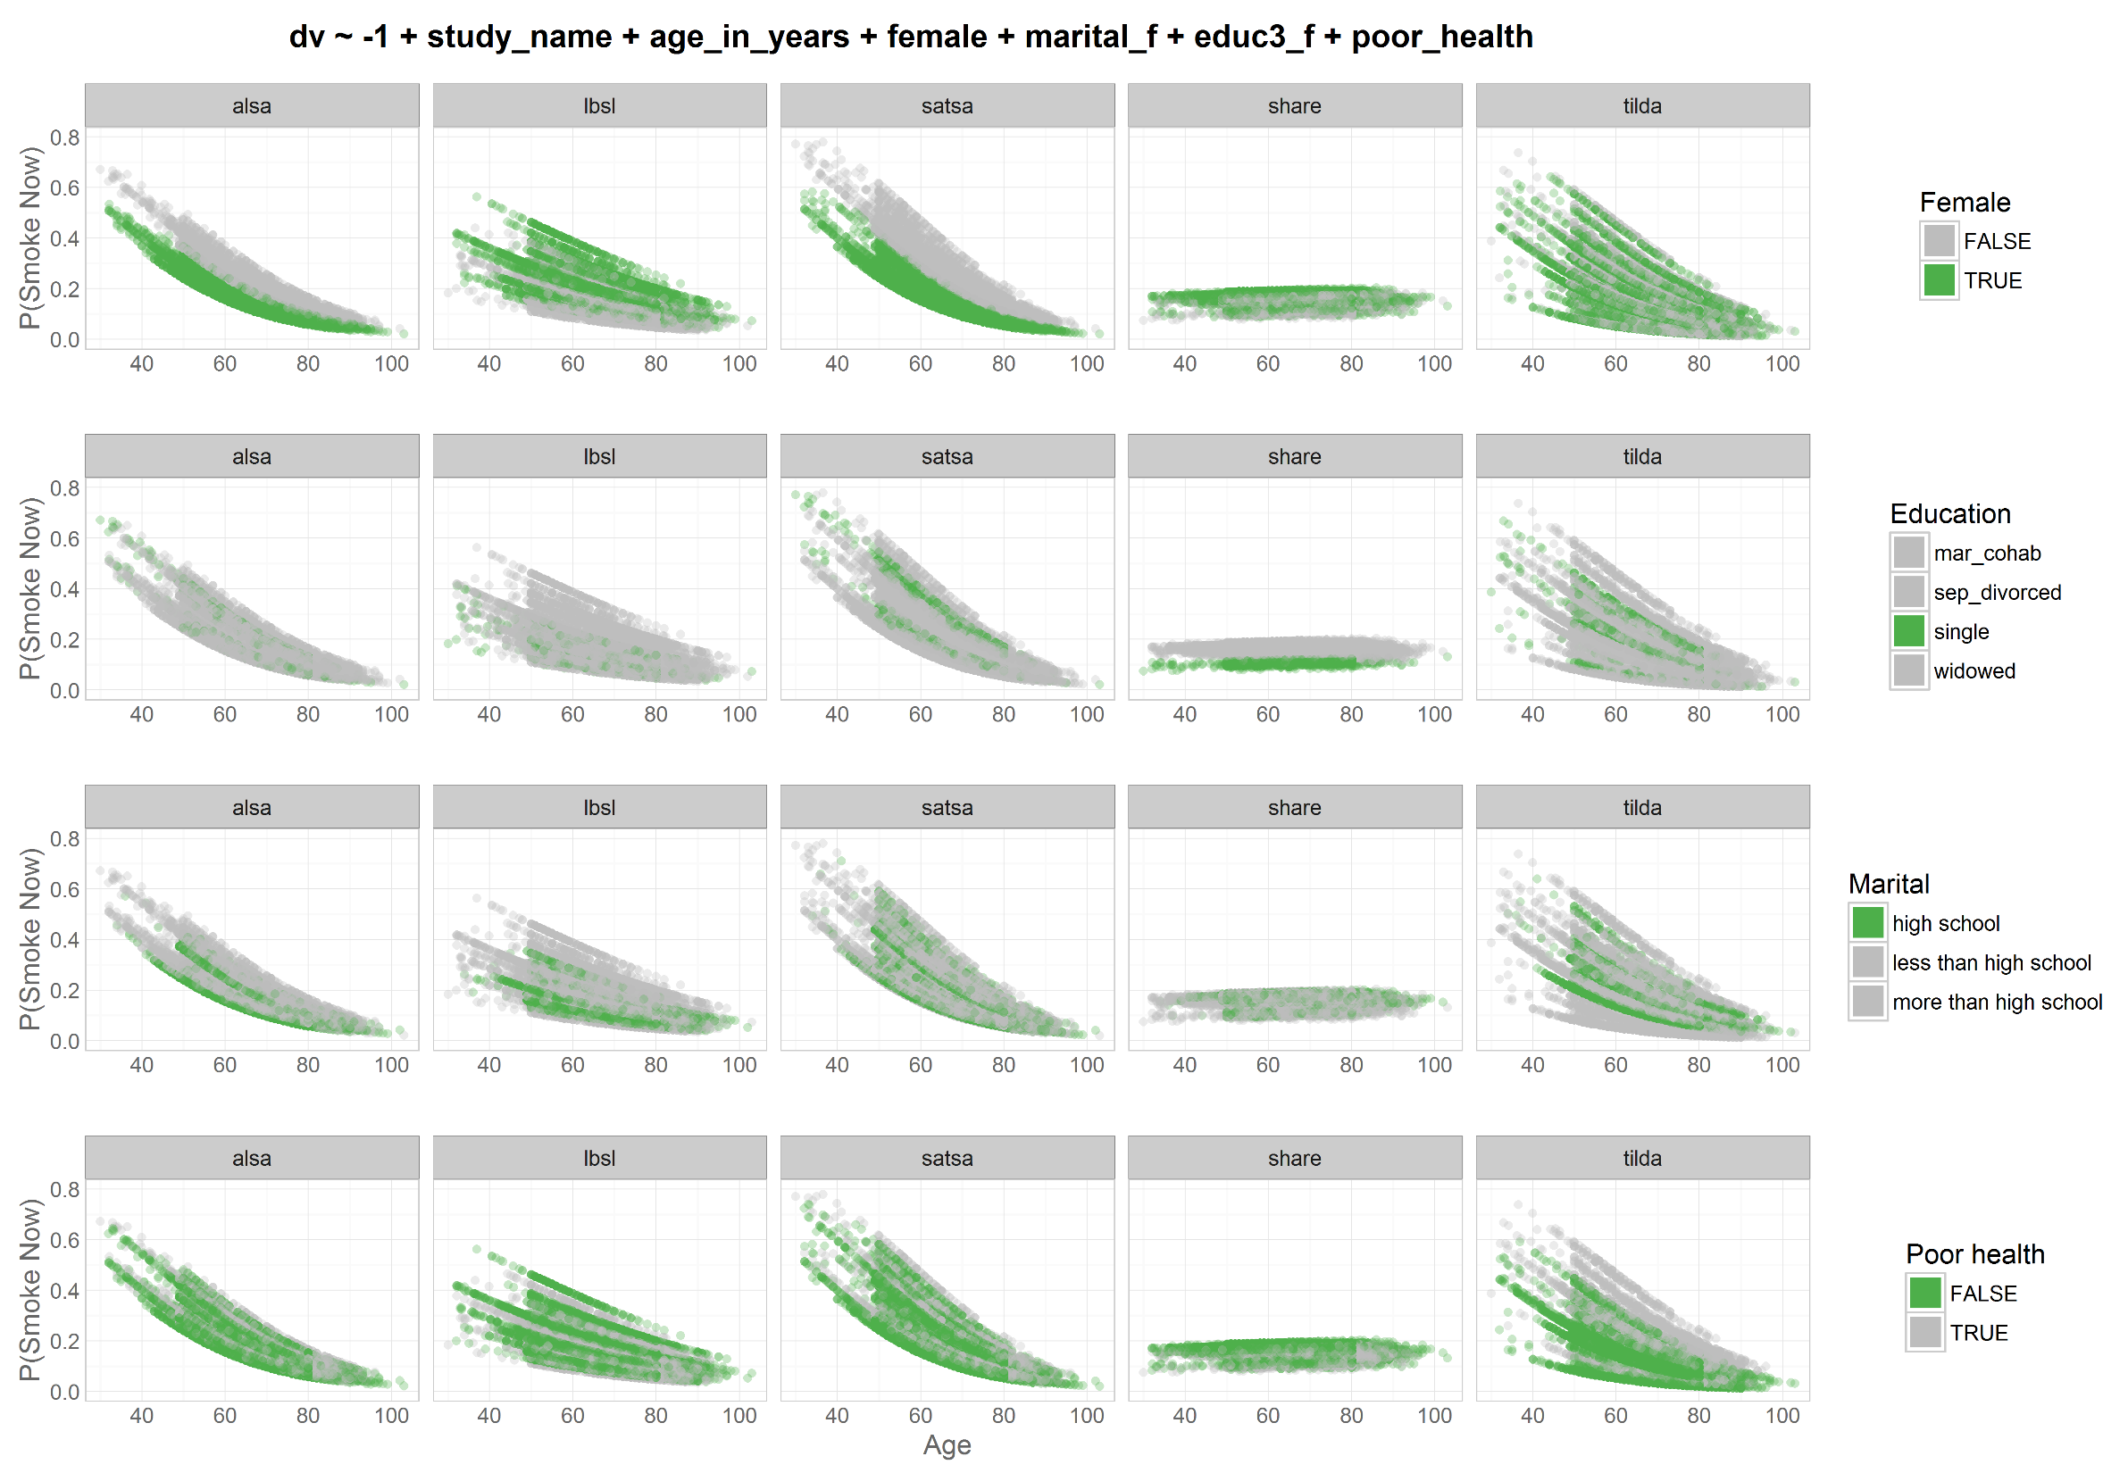
Odds|
|Prob
dto
harmony
dto

Slide 35
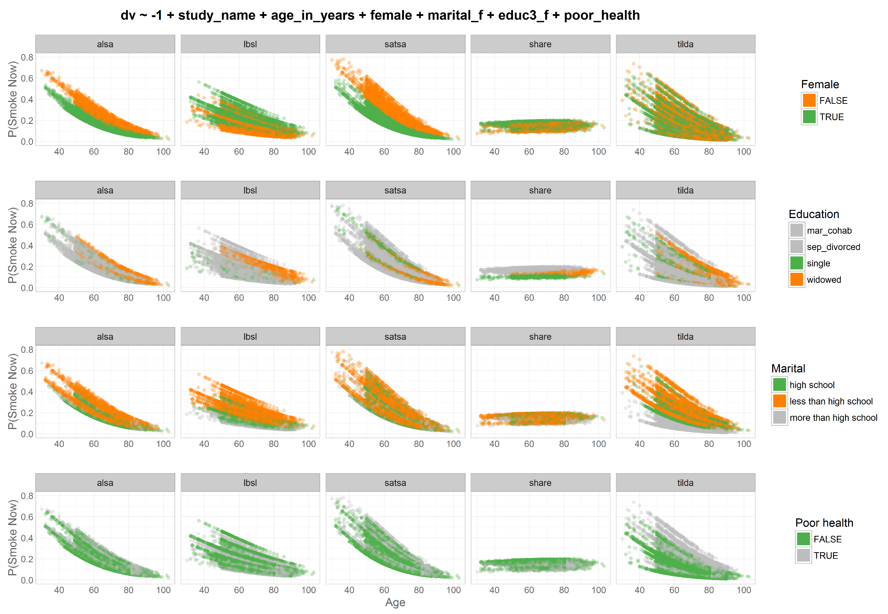
Odds|
|Prob
dto
harmony
dto

Slide 36
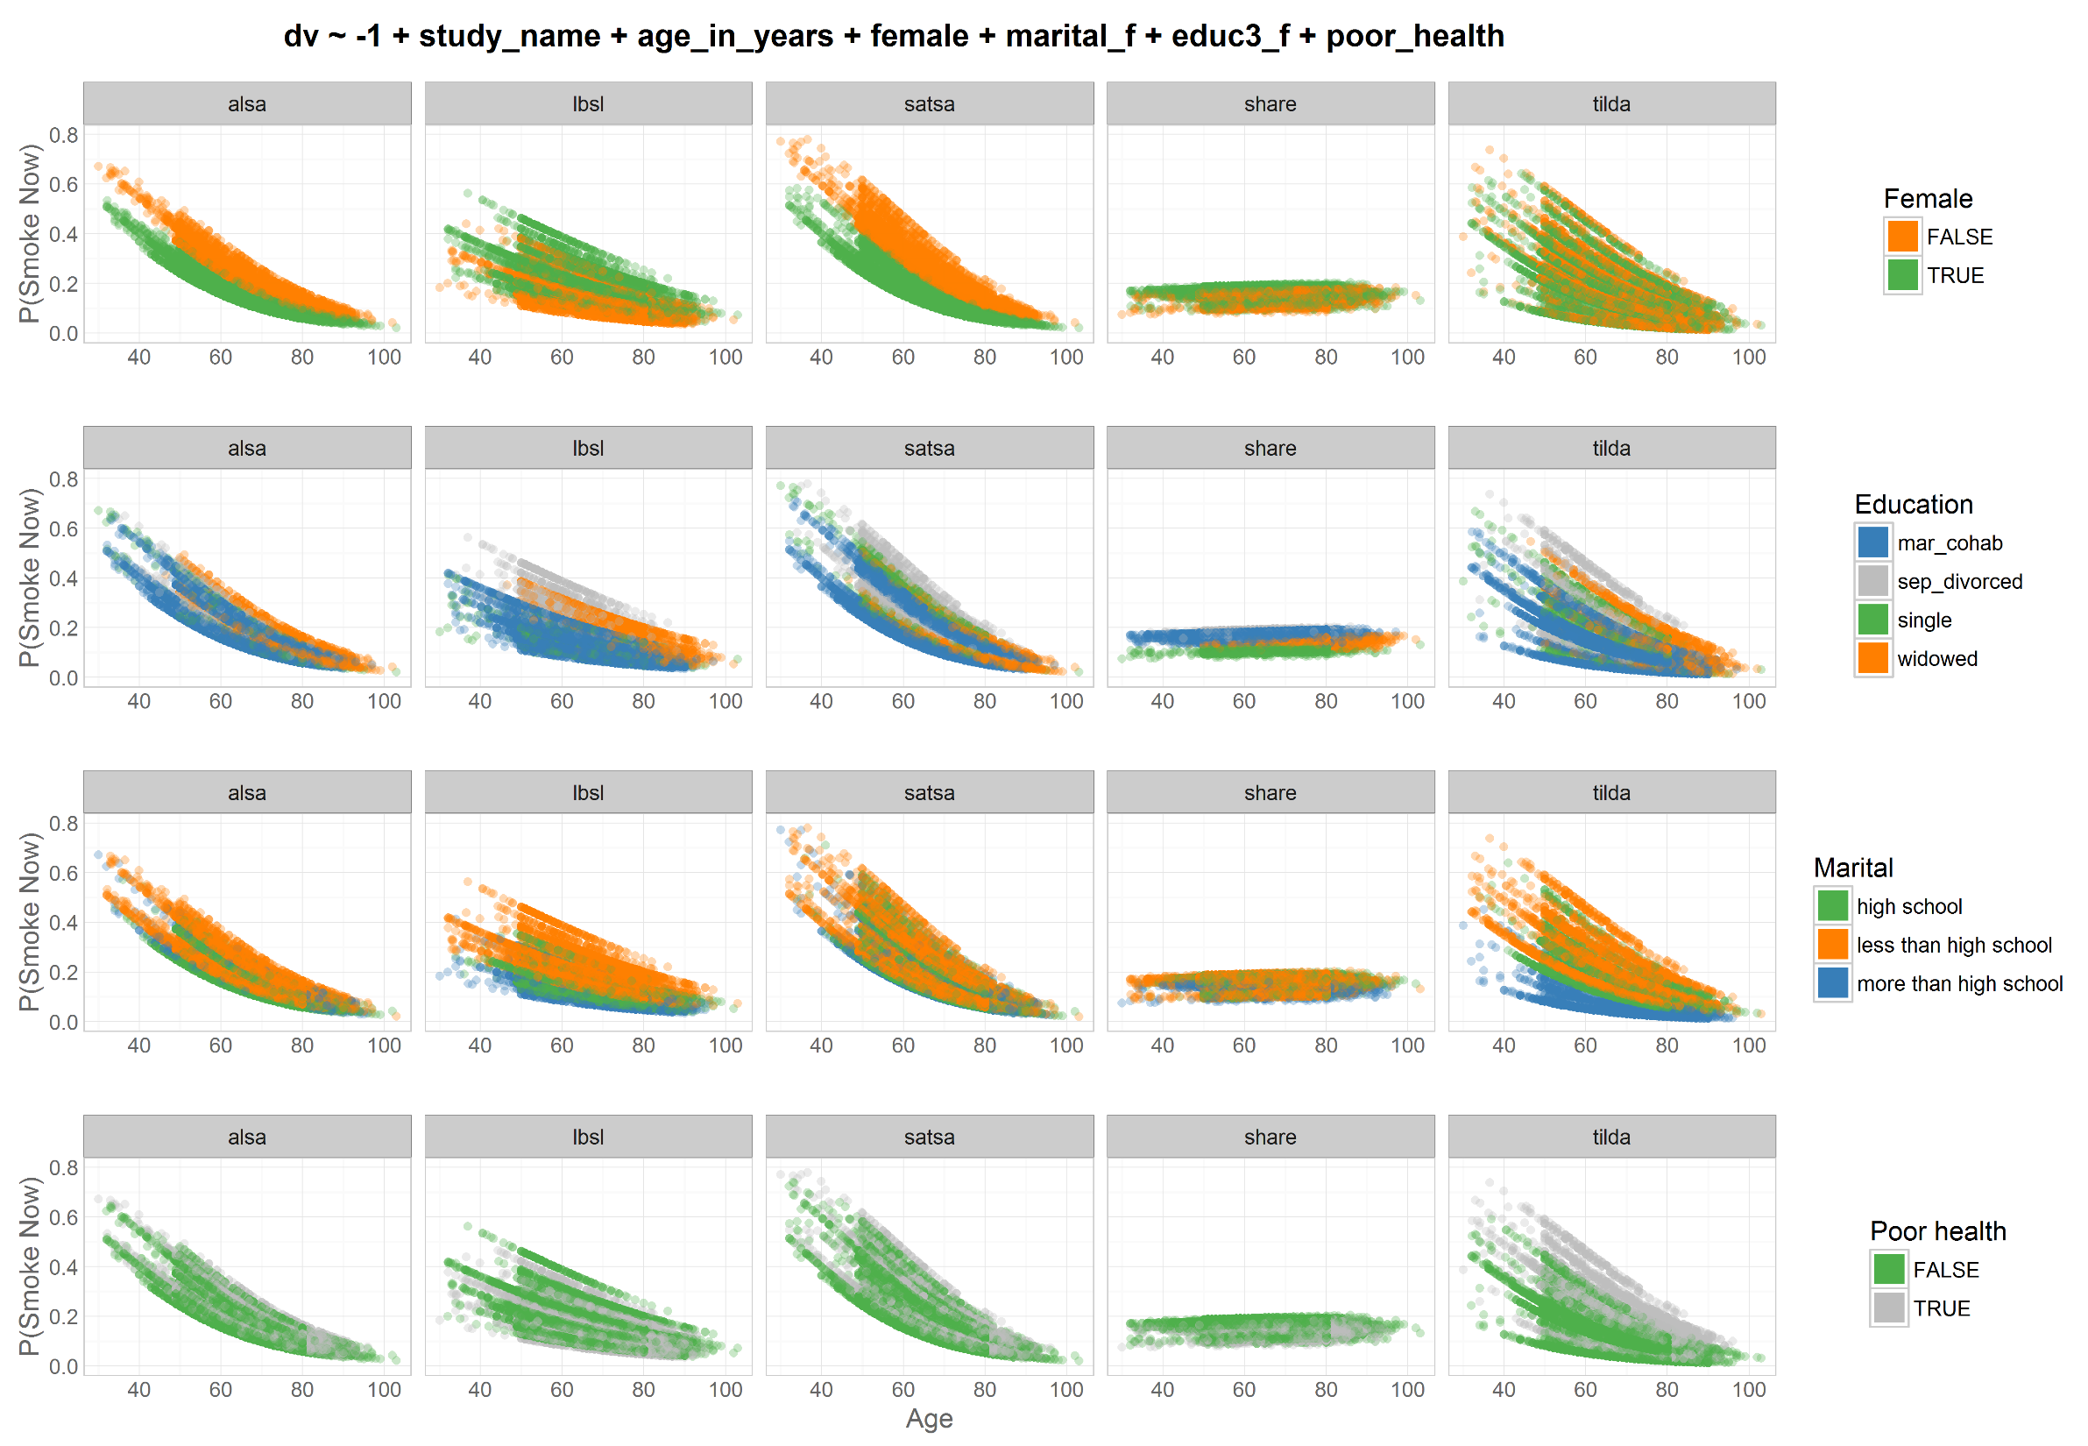
Odds|
|Prob
dto
harmony
dto

Slide 37
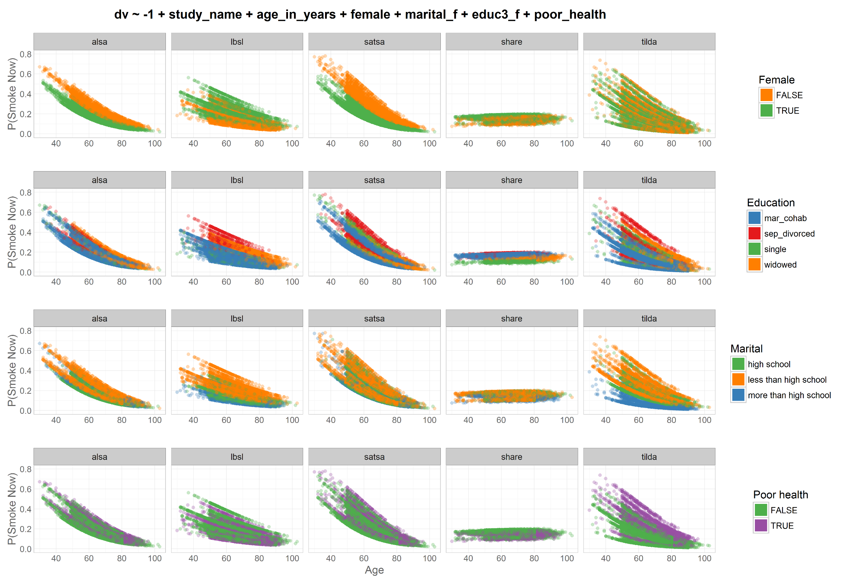
Odds|
|Prob
dto
harmony
dto

Slide 38
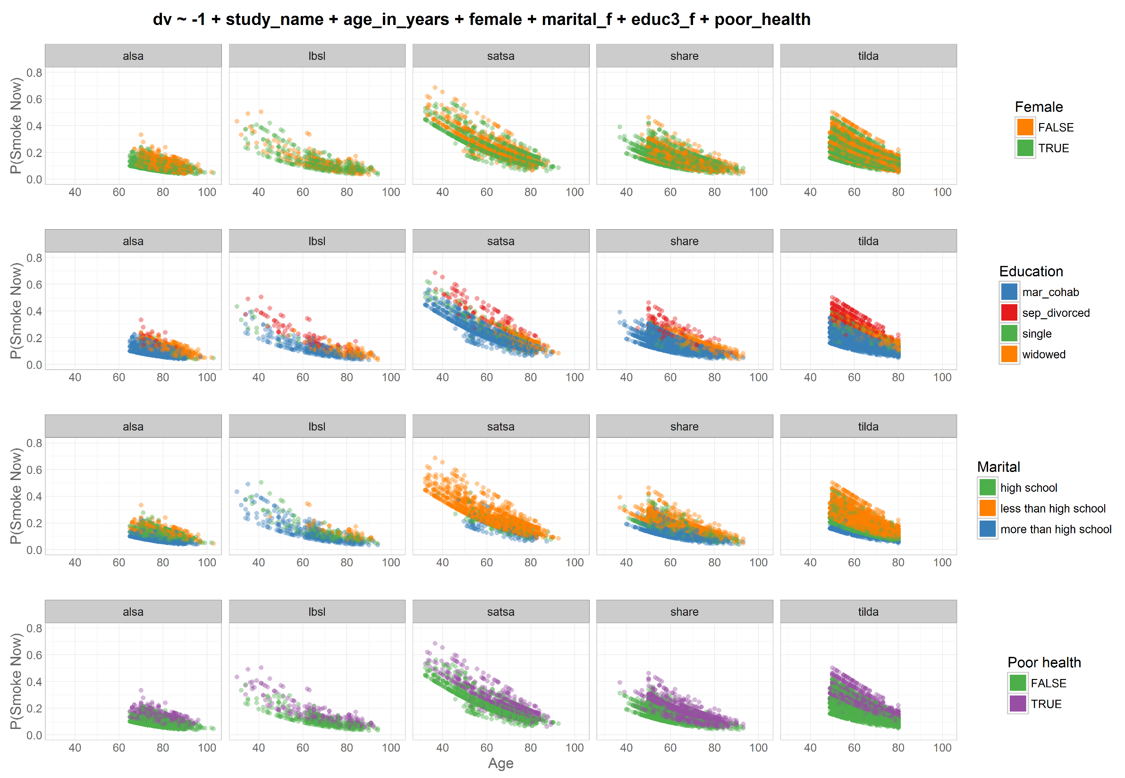
Odds|
|Prob
Study =
factor
dto
harmony
dto

Slide 39
Odds|
|Prob
Study =
cluster
dto
harmony
dto

Slide 40
Odds|
|Prob
Study =
factor
dto
harmony
dto

Slide 41
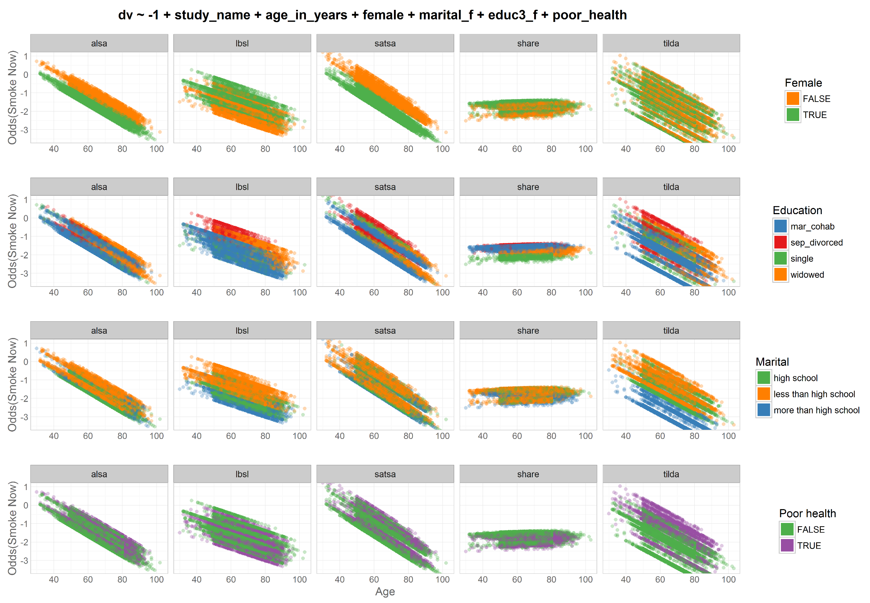
Odds|
|Prob
Study =
cluster
dto
harmony
dto

Slide 42
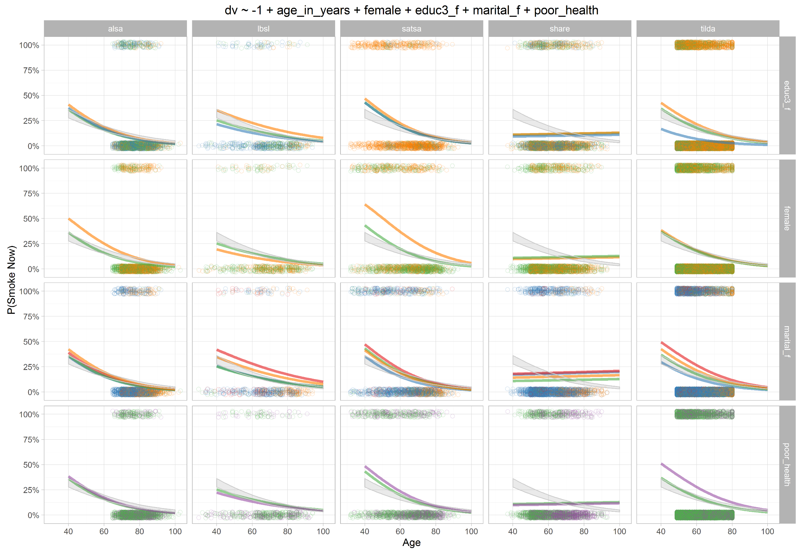
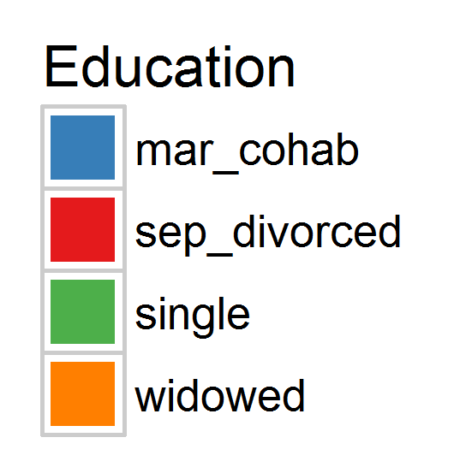
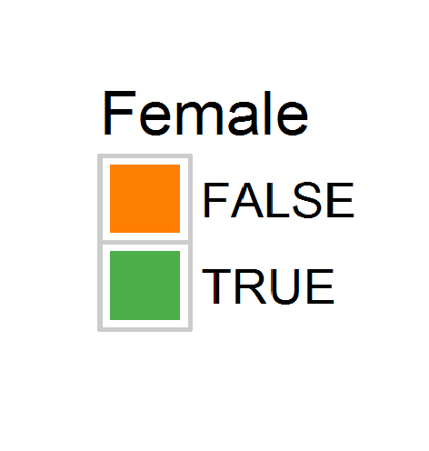
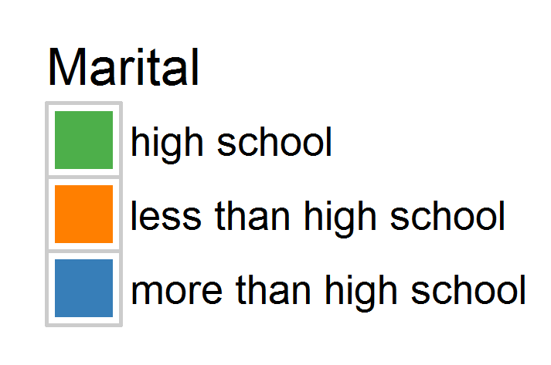
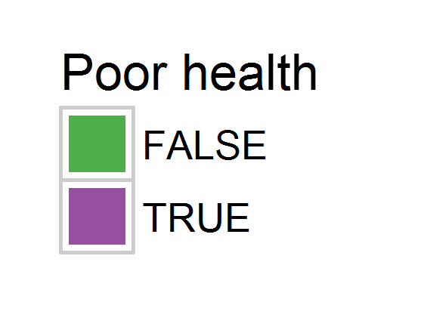
Odds|
|Prob
Study =
cluster

Slide 43
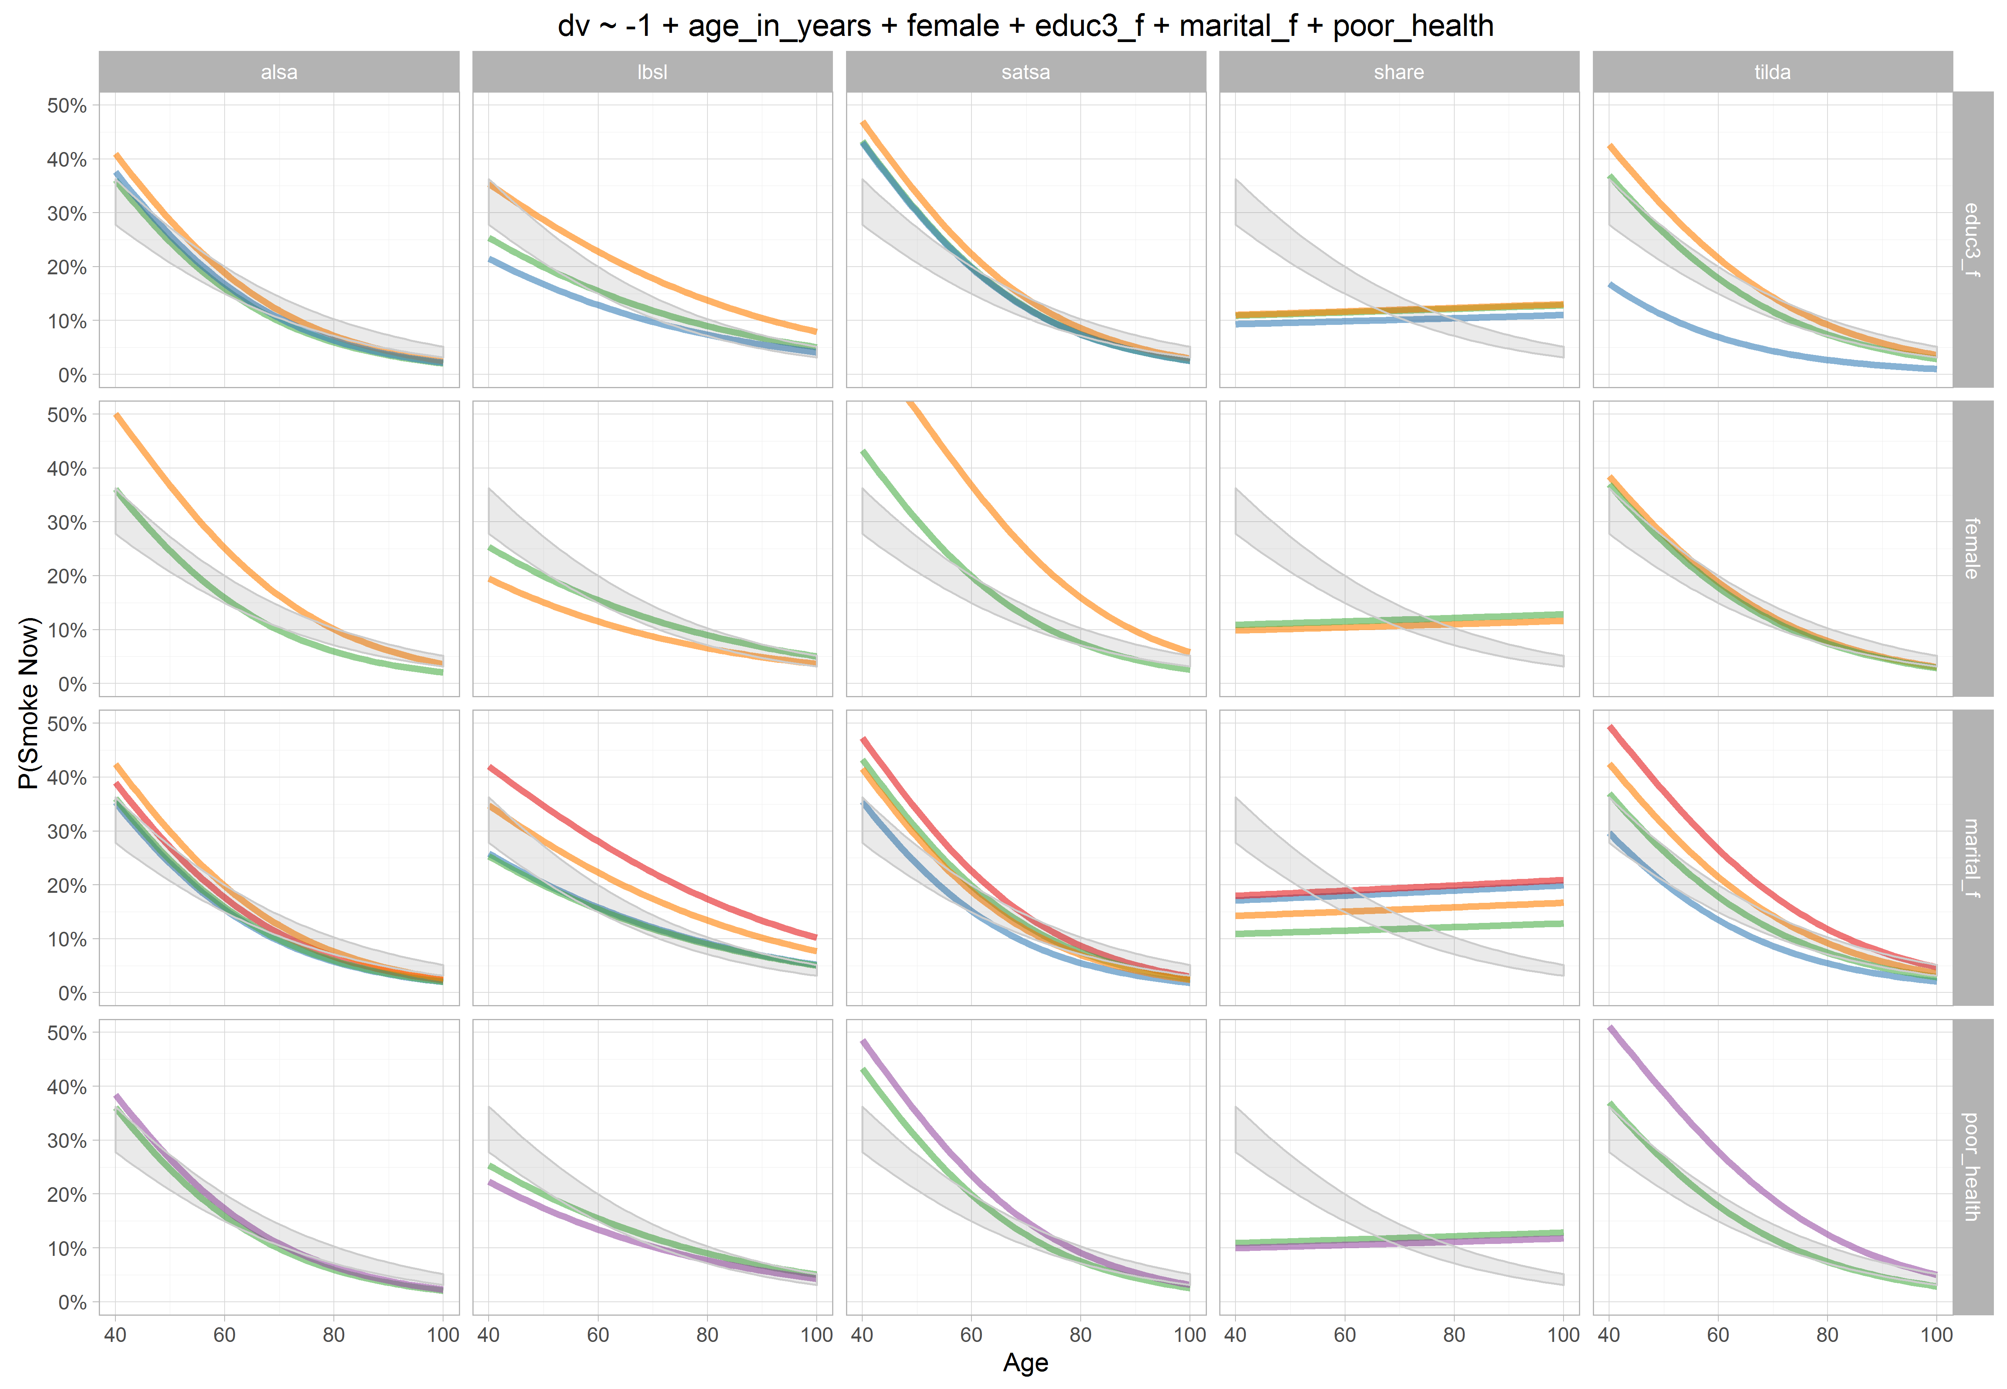
Odds|
|Prob
Study =
cluster

Slide 44
dto
graph
smoked_ever
harmony
dto
model

Slide 45
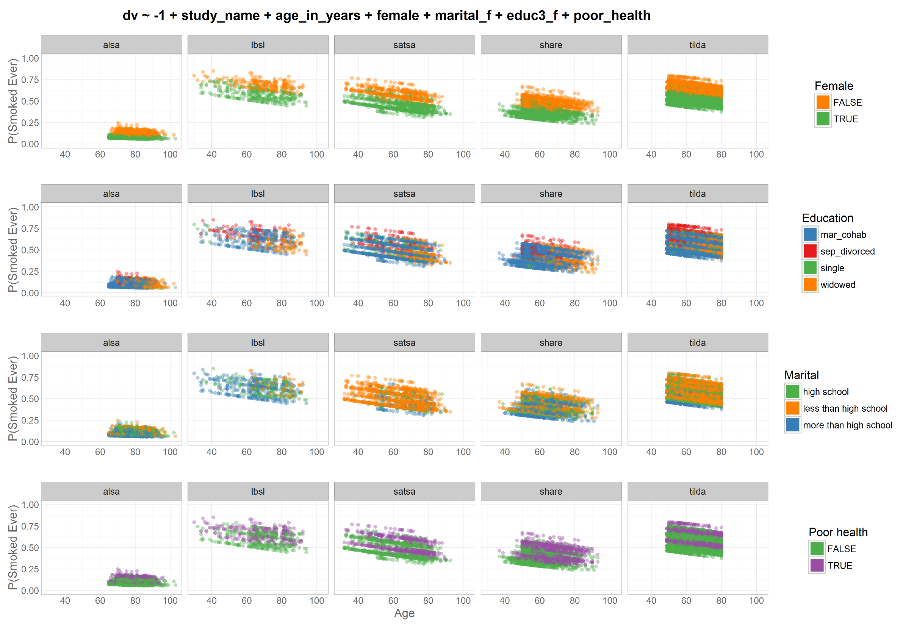
Odds|
|Prob
Study =
factor
dto
harmony
dto

Slide 46
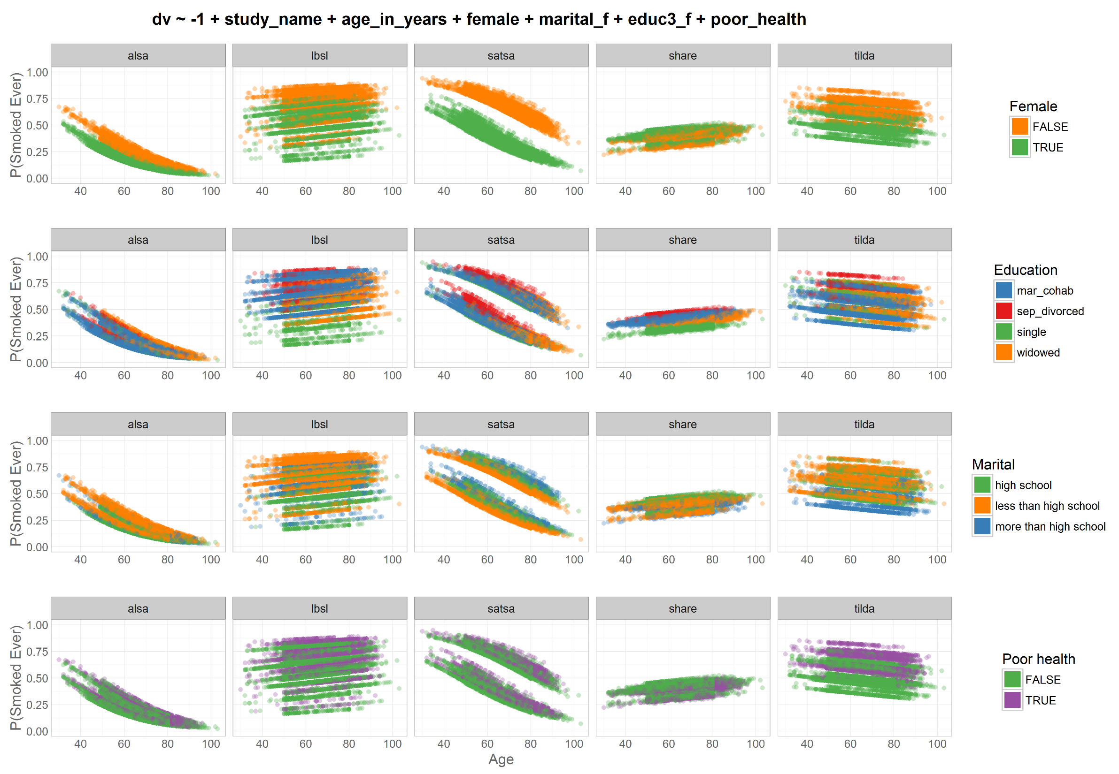
Odds|
|Prob
Study =
cluster
dto
harmony
dto

Slide 47
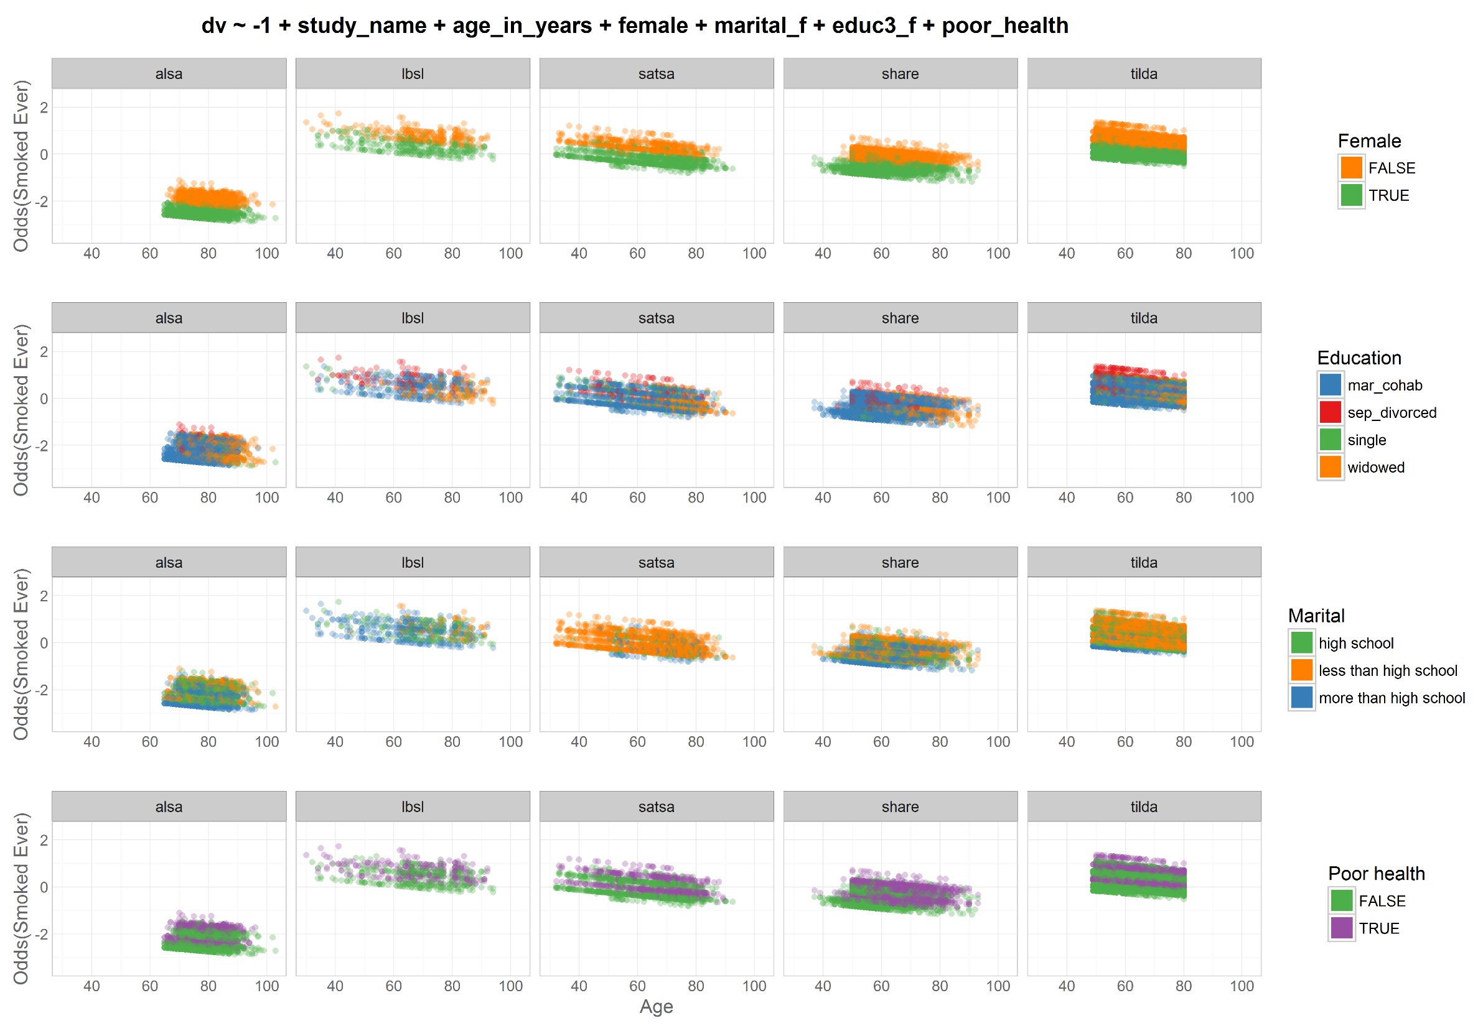
Odds|
|Prob
Study =
factor
dto
harmony
dto

Slide 48
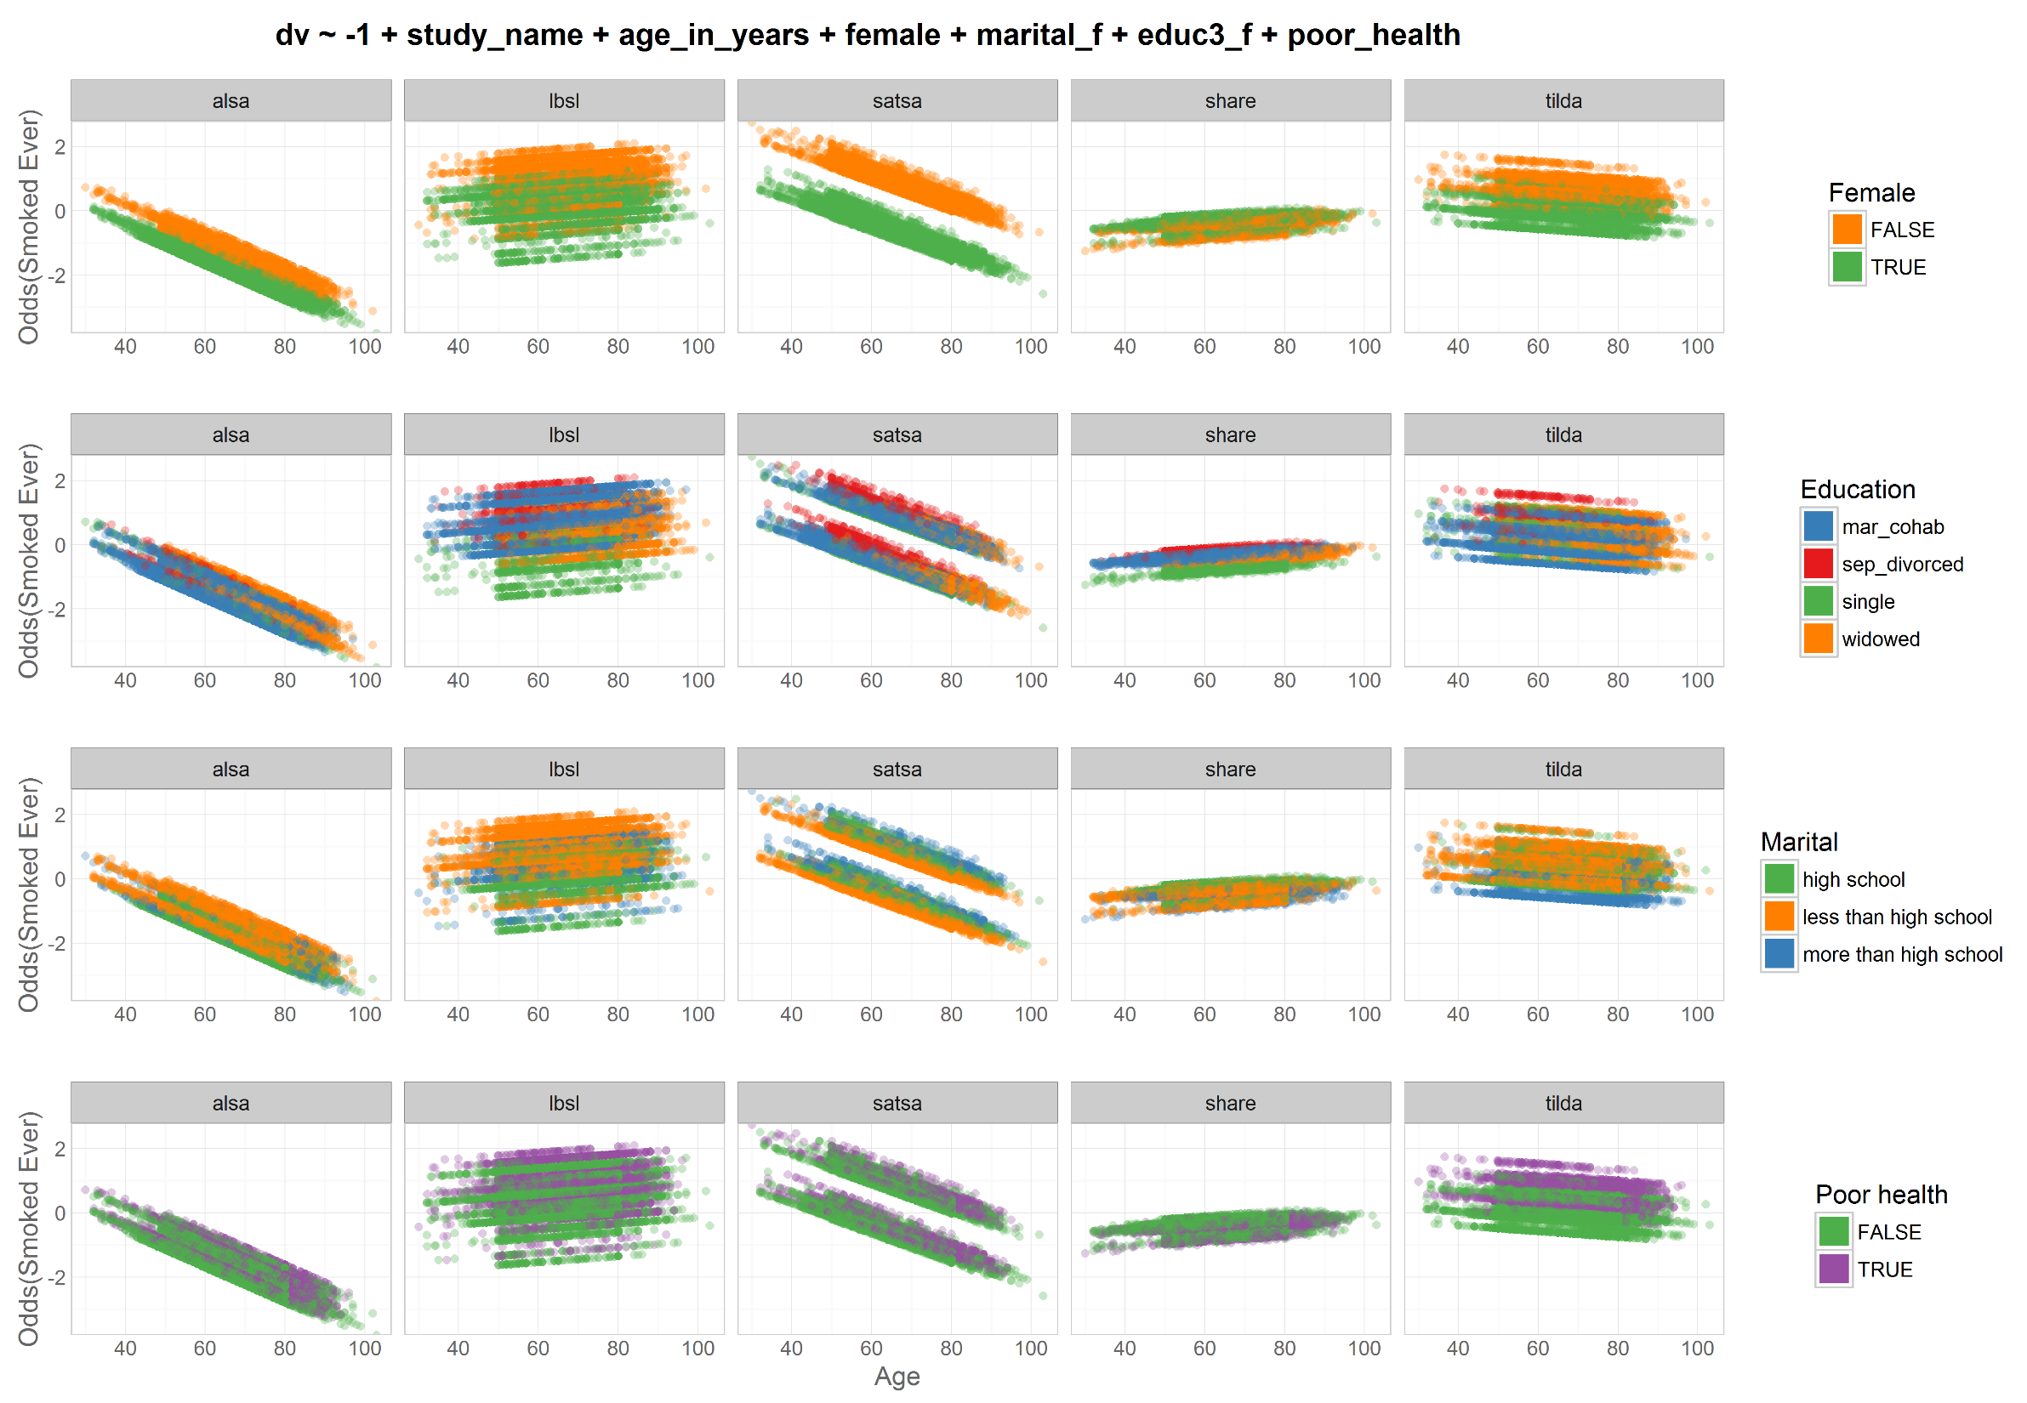
Odds|
|Prob
Study =
cluster
dto
harmony
dto

Slide 49
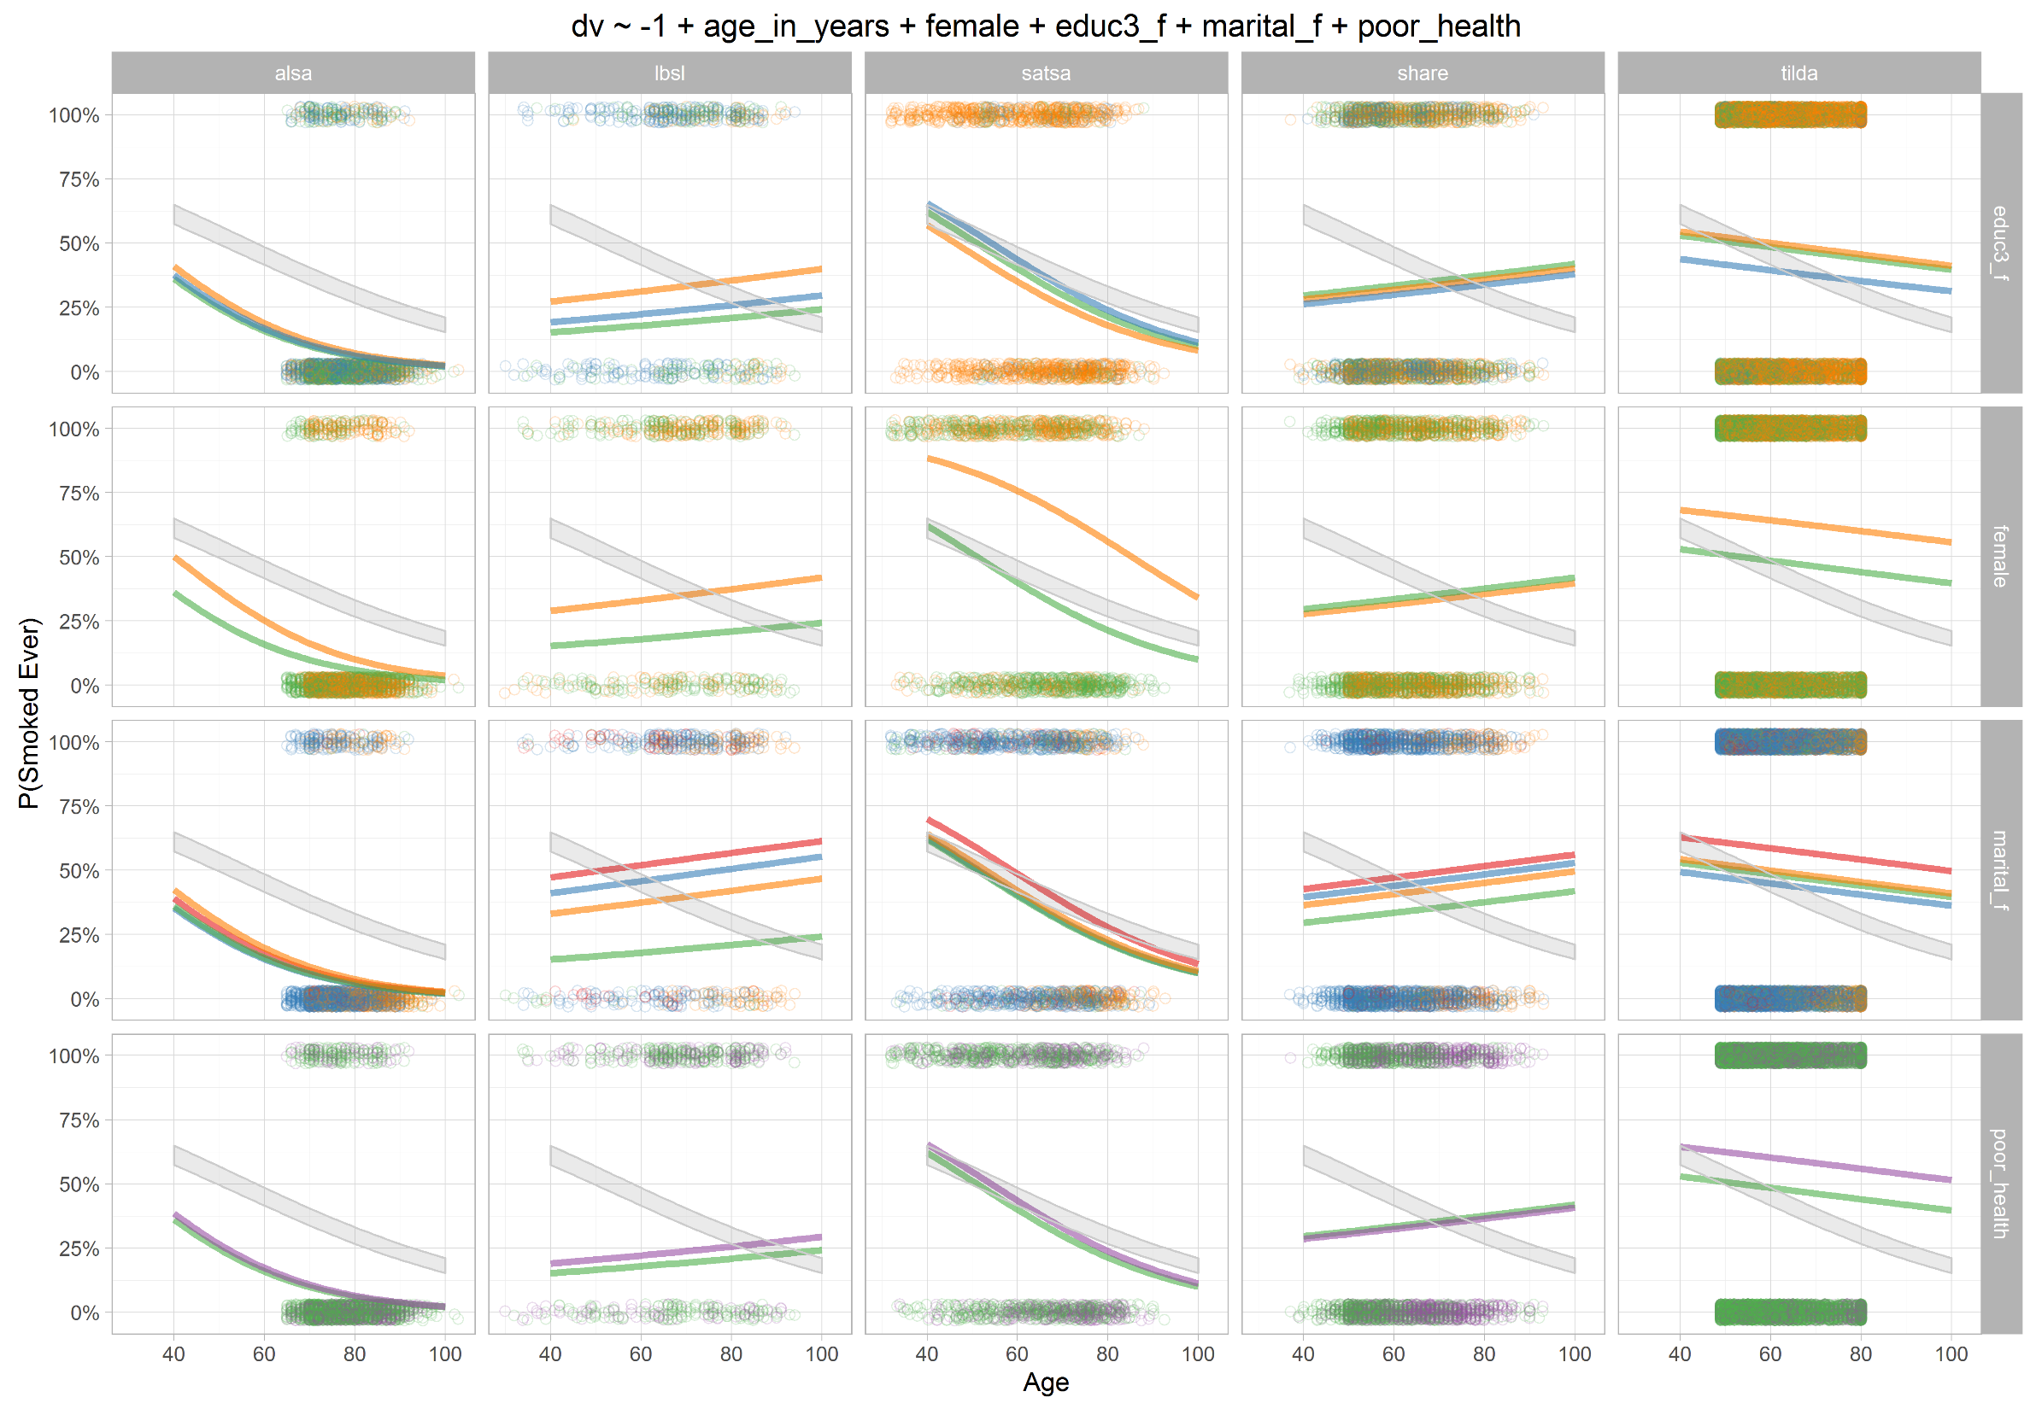
Odds|
|Prob
Study =
cluster

Slide 50
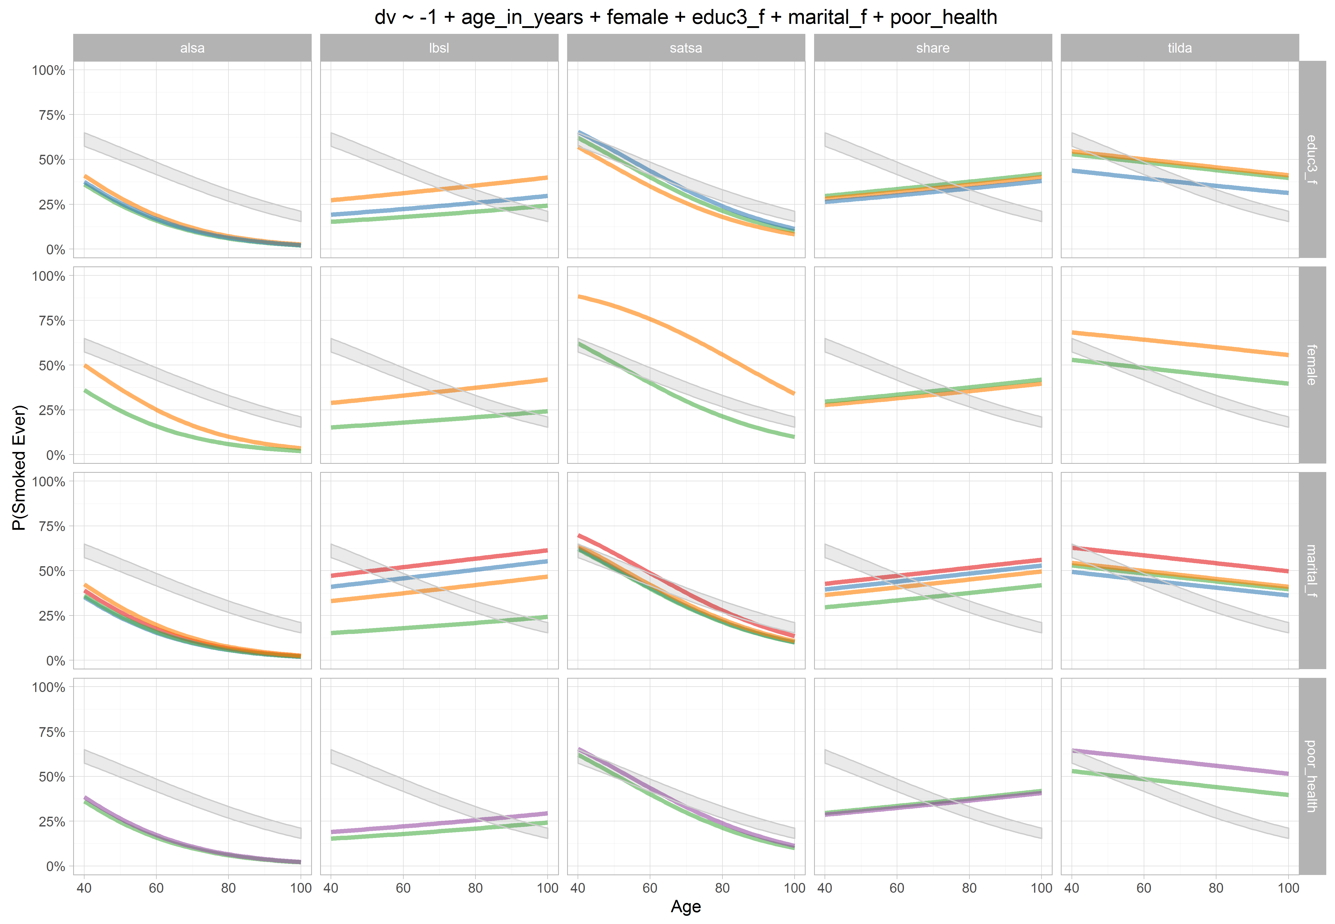
Odds|
|Prob
Study =
cluster

Slide 51
5 voices, 10 stories:
Groningen Harmonization Exercise
IALSA team
Andrey Koval, University of Victoria
Andrea Piccinin, University of Victoria
Scott Hofer, University of Victoria
Graciela Muniz, University College London
Special thanks
William Beasley, University of Oklahoma

